Slide 1
PRG Lead – Meeting – 3.1.2018

Slide 2
Content
PRG organization updated (10’)
Review PRG Department OKRs (10’)
Which ones in PRG Lead’s OKRs are hard to achieve? (20’ : discussion)
Sharing : Innovation & Motivation (15’ : sharing & discussion)
Resource classification : 20% - 60% - 20% (10’ : discussion)
PRG Survey S1 2018 (15’ : discussion)
Last thing

Slide 3
1. PRG organization updated
Studio Lead
Mai Thanh Xuan
PHD Division Lead
Nguyen Minh Vien
PHD C++ Project Lead
To Chi Thanh
PHD Java Project Lead
Nguyen Xuan Thinh
PHD Deployment
& RnD Lead
Nguyen Van Hoang
Tech Expert-main assistant
Bui Do Trong
HRP Division Lead
Hoang Xuan Khanh
Supervisor- main assistant
Nguyen Duc Quy
AndroidHD Division Lead
Luong Thanh Hai
Supervisor-main assistant
Tran Tu Hoang
Windows Division Lead
Tu Dinh Tan
Project Lead – main assistant
Le Quang Quoc Son
Trainer Lead
Dang Thi P. Thao
Trainer – main assistant
Nguyen Duc Tai
Notes:
How about the back-up for Studio Lead on general matters?
Confirm for master list (select a lead or trainer lead?)
Confirm recruitment plan (trainer lead?)
Salary matter : HR to reach by phone.
Division matters : fully in-charge by division lead

Slide 4
1. PRG organization updated (cont.)
What do you think about?
- The organization is heavy and overlap?
- How about the back-up for Studio Lead?
- What is target for organization in S1 and S2?
Notes:
How about the back-up for Studio Lead on general matters?
Confirm for master list (select a lead or trainer lead?)
Confirm recruitment plan (trainer lead?)
Salary matter : HR to reach by phone.
Division matters : fully in-charge by division lead

Slide 5
2. Review PRG Department OKRs
Link on the Confluence : https://confluence.gameloft.org/pages/viewpage.action?pageId=119841555

Slide 6
3. PRG Lead’s OKRs : which KRs are hard to achieve
Sharing from each division lead lead and discuss together to foresee a draft solution and actions for “which KRs are hard to achieve”

Slide 7
4. Sharing : Innovation & Motivation
Why talking about Innovation and Motivation?
Review the company’s core values?
Notes:
Innovation : a must need for software company (Innovation Is the Key to Survival)
Motivation : the main point to let people do best job

Slide 8
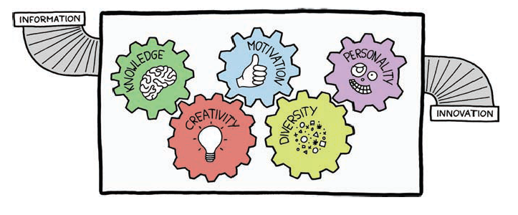
4.1 - Innovation
Notes:
Reference : Management 3.0 book (page 51 : The Information-Innovation System)
Knowledge : knowledge worker (built from information of environment, education, learning, request, feedback…)
Creativity : should be original and useful → try to do something new and useful (it also is solving old problem by new way)
Motivation : people want to do the job and put energy into
Diversity : include different people with different properties (of course still adapt with the requirement) --> to be flexible and adapt to change easily
Personality : should have some virtues being shared with all team members (example : trust, openness, commitment, focus, courage…)

Slide 9
4.2 - Motivation
What is Extrinsic Motivation?
What is Intrinsic Motivation?
Which one to be focused and our actions?
Notes:
Extrinsic Motivation : motivator factors from outside of people such as : salary & bonus, also include praise and compliments .It sometime works and hard to control, complex to be foreseen
Intrinsic Motivation : motivator factors from inside of people due to they like the job, feeling working as playing.
We have identified two important reasons for managers to focus on intrinsic motivation. It turns out that, in complex systems, the side effects of extrinsic motivation are unpredictable and often outweigh the benefits. Furthermore, researchers have found that creativity, that crucial link between knowledge and innovation, is best served by intrinsic motivation, not by extrinsic motivation.

Slide 10
5. Resource classification
Classify the resource to be 3 parts:
20% talents
60% normal people
20% weak people
What do you think?
Notes:
- Talent group : should be about 20% resource. It is NOT must be only for Supervisor/Expert/Lead or Senior -> it is for the guys who has high contribution/motivation for team/project, playing an important role (you imagine without those guys => the project is not going as expected) or even for the junior guy who has high possibility to grow up fast
Normal group : should be about 60% resource, include the guys who is replaceable (meaning if he/she leave, we can replace by someone in team)
Weak group : should be about 20% resource, include the guys who have low contribution to the project, working under expectation

Slide 11
6. PRG Survey S1 2018
PRG Survey : why we need it?
To know clearly team members
Team members to review themselves
To take the actions to be fit dev properties & company strategy

Slide 12
6. PRG Survey S1 2018 (cont.)
Focus on some parts:
1. Ability – tech skill : help them to realize what they have and what need to improve
2. Ability – soft skill : help them to realize what they have and what need to improve
3. Motivation : to see the main their motivation (from extrinsic or intrinsic)
4. Comments & Ideas : comment for activity and what they expect from department/company to focus on

Slide 13
7. Last thing
Do you think WHAT I Should focus to do in S1 2018?

Slide 14
Studio Lead PRG
4. Work with trainers on communication with University and Student community
1. Involve directly to studio challenge projects
2. Build DAD Programmer to be more visibility to Managers and Worldwide
3. Improve 3D & Game Engine skill
1. PHD 3D Training
2.Prototype Lab
3. Setup AndroidHD RnD
4. Android & Windows merging projects
1. Build relationship with world technical directors & more involve in worldwide discussion
2. Involve PRG Leads & getting opinion on studio discussion with other managers
3. Getting managers to be closer to Programmer Lead (by more sharing/talking & seating closely)
1. More self-practice
2. Handle at least 1 topic in PHD 3D Training
3. Focus on these parts on creating questions in Code Challenge
4. Contribute to local technical review
Setting teaching cooperation with Duy Tan University
Build “engagement program” with students who has PRG certificates

